Slide 1
Erie Ave & Murray Rd Improvements
  Redesigning key intersections
  Shortening crosswalks at key intersections
  Adding protection to existing bike lanes
  Adding sidewalk along Murray Rd
  Improving trail system connections

Slide 2

What travel modes do you use on Erie Ave?
0.5% Other
33.6% Walk
5.3% Transit
38.9% Drive
21.7% Bike

Slide 3
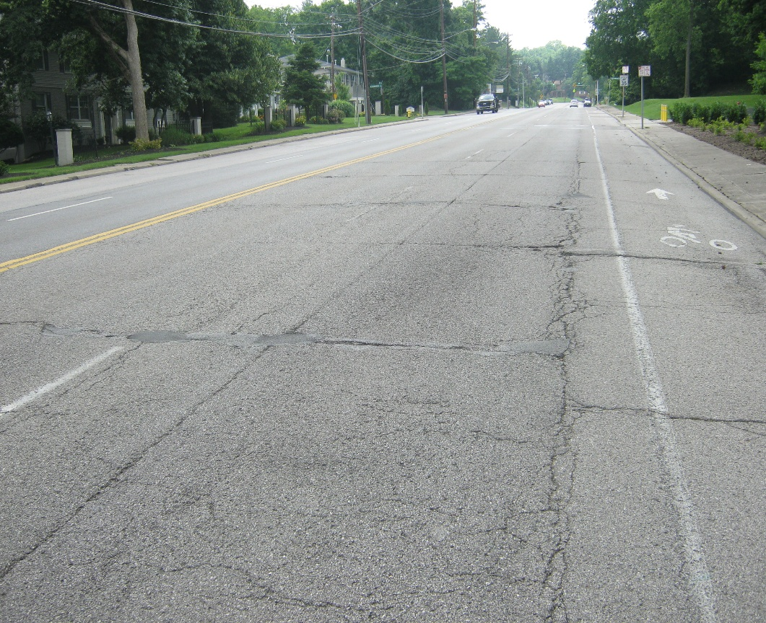
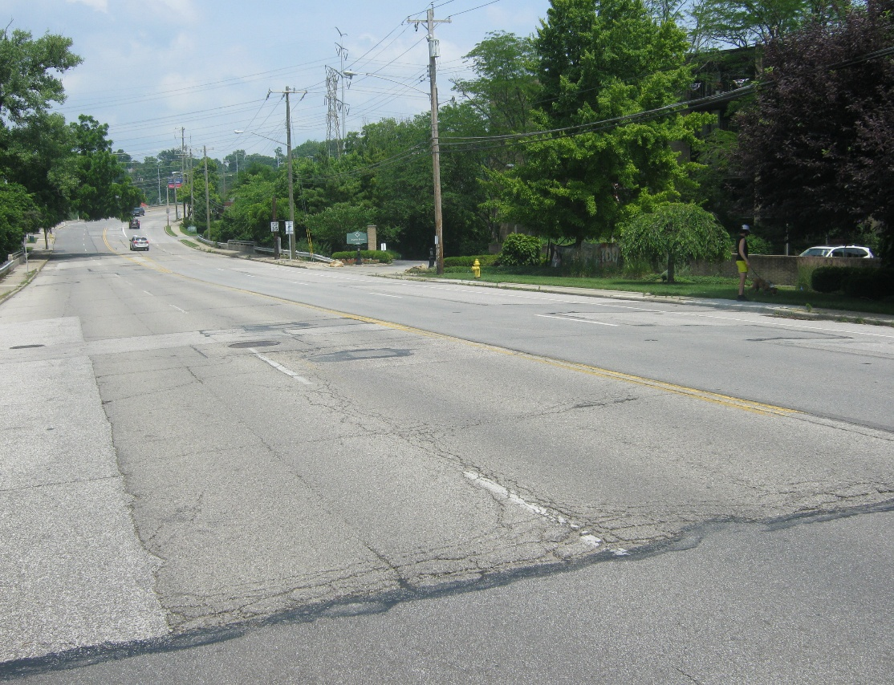
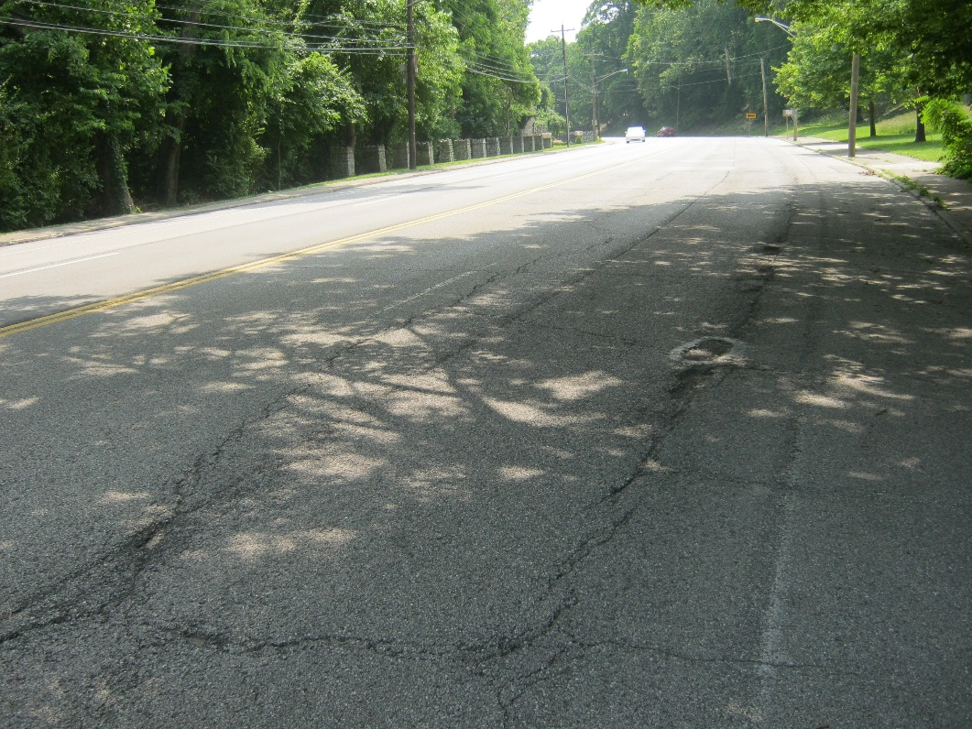

Slide 4

As a pedestrian, how comfortable do you feel crossing Erie Ave at Rosslyn Dr?
7.3% Very comfortable
4.8% Somewhat comfortable
15.8% Neutral
43% Very uncomfortable
29.1% Somewhat uncomfortable

Slide 5
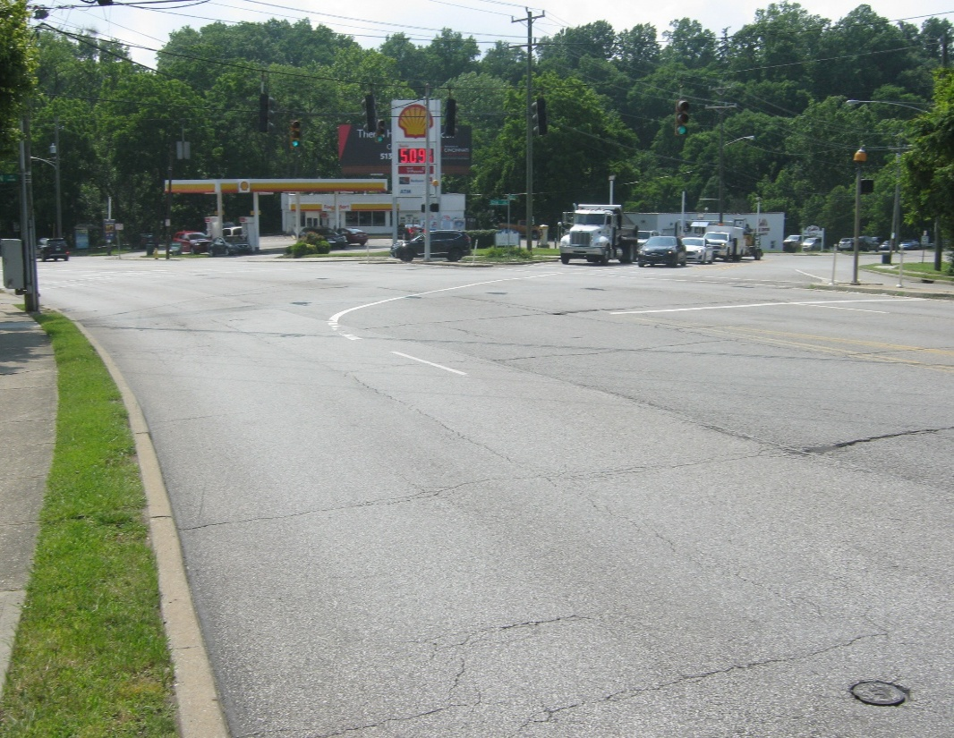
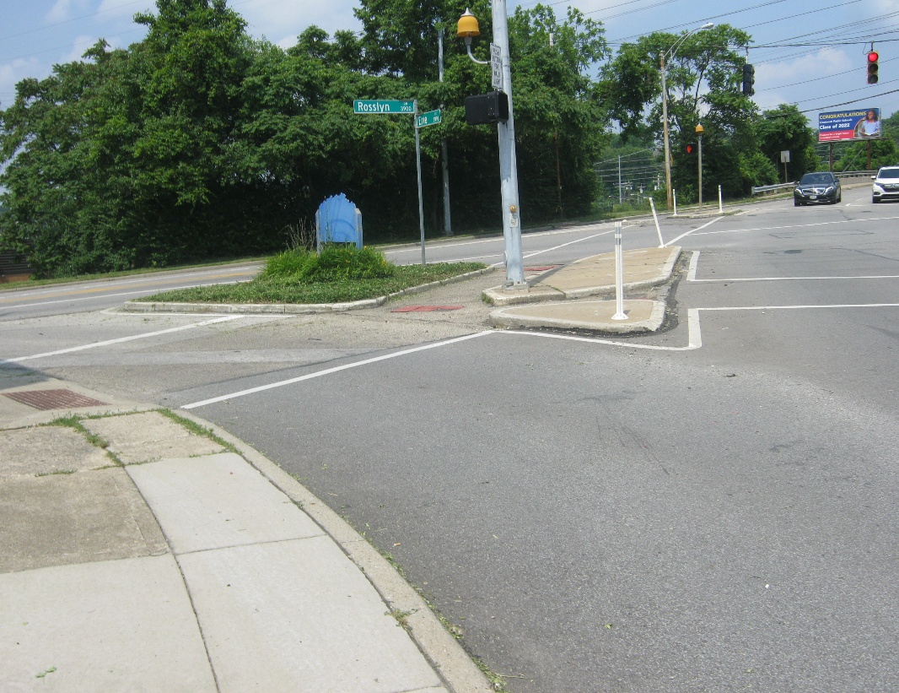
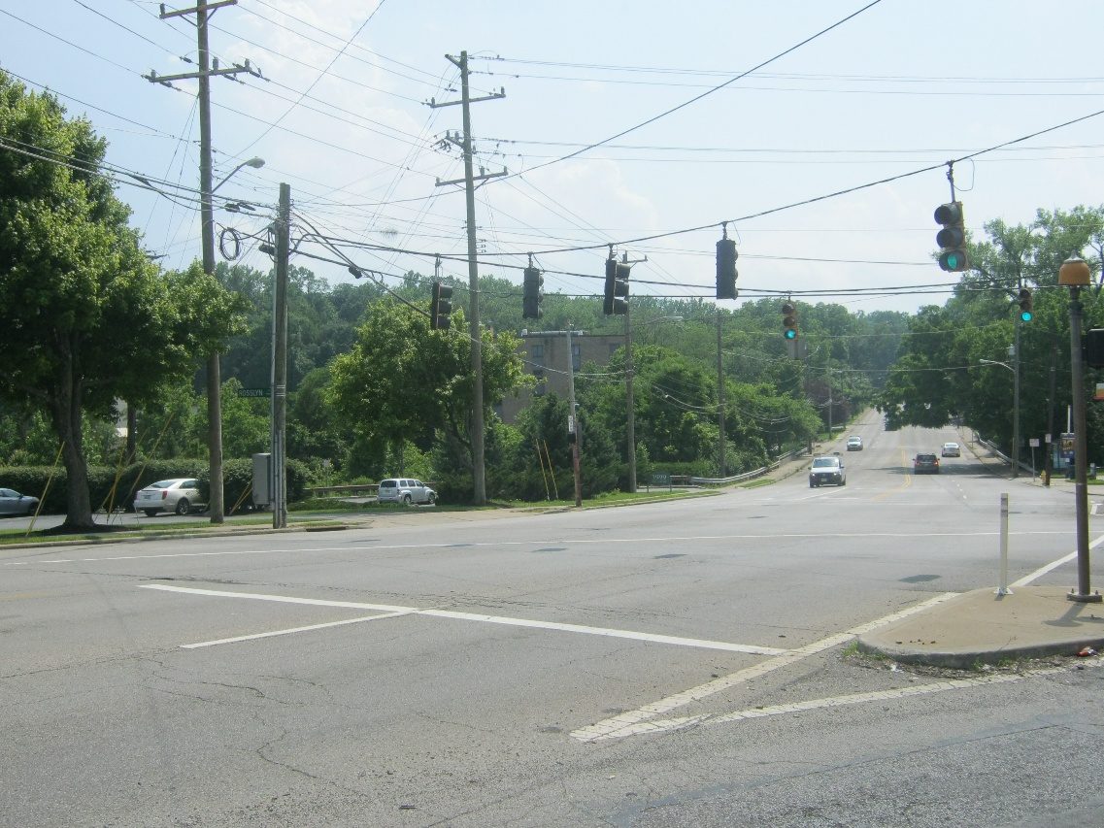

Slide 6

What travel modes do you use on Murray Rd?
0.6% Transit
30.4% Walk
44.6% Drive
24.4% Bike

Slide 7
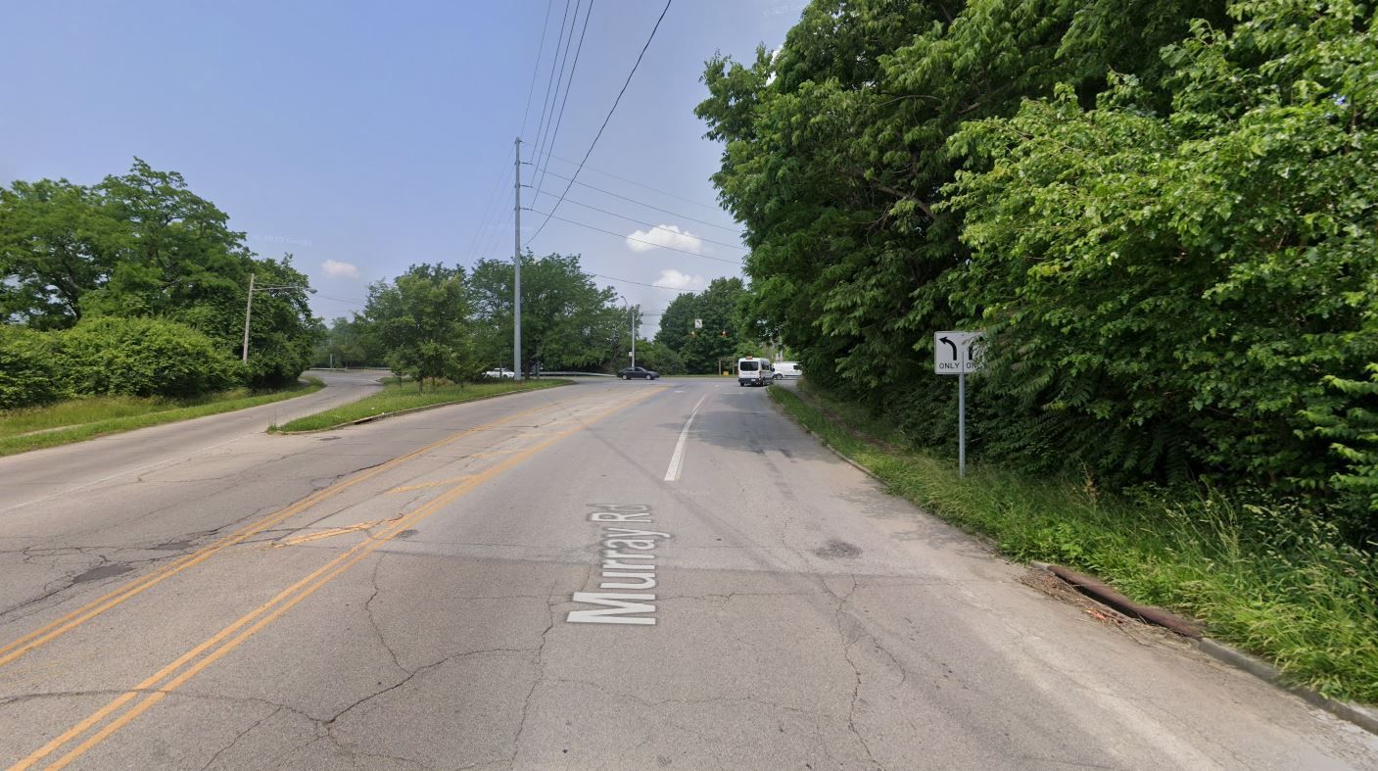
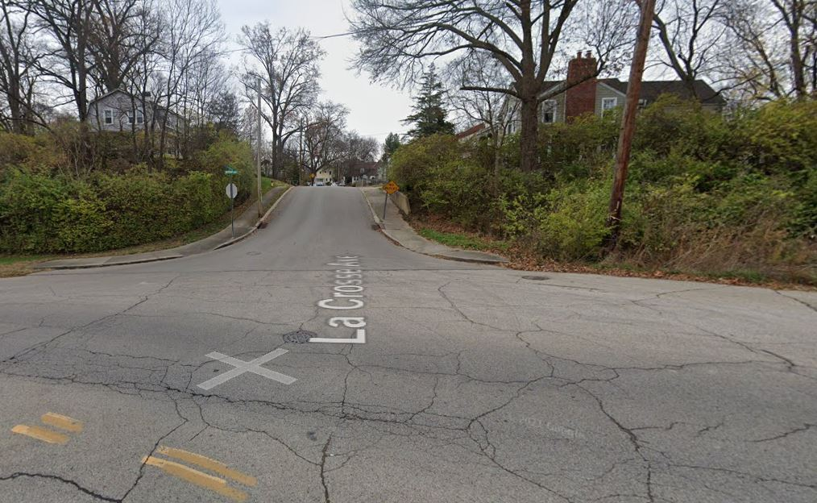
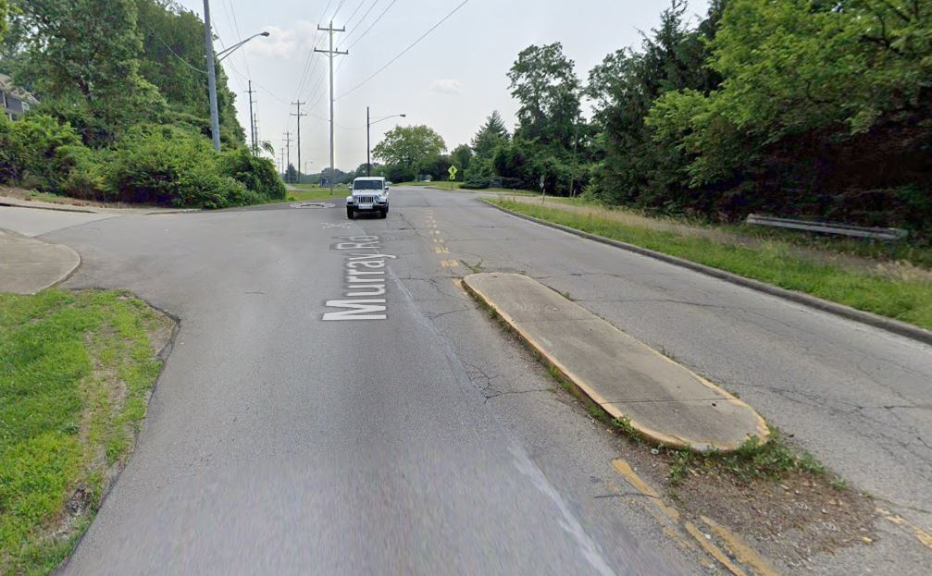

Slide 8

As a pedestrian, how comfortable do you feel crossing Erie Ave at Murray Rd?
6.6% Very comfortable
6% Somewhat comfortable
35.5% Very uncomfortable
16.9% Neutral
34.9% Somewhat uncomfortable

Slide 9
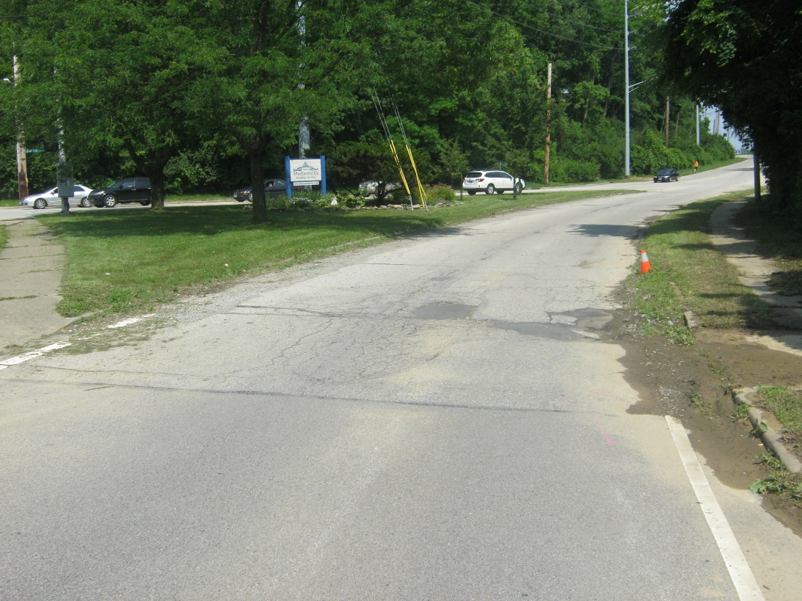
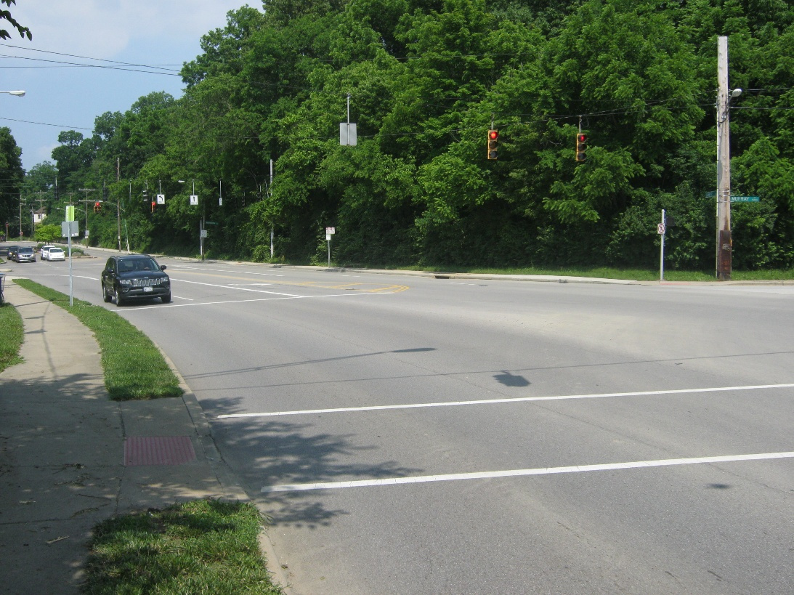
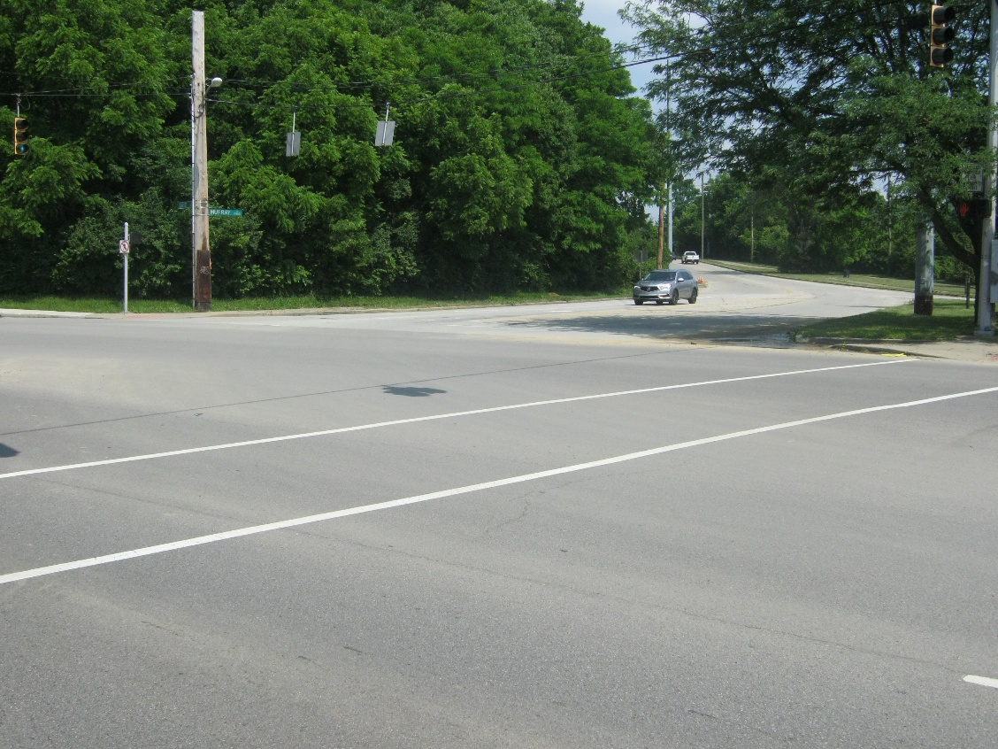

Slide 10
Top Comments from Survey Respondents
  General concerns about speeding on Erie Ave.
  Rough road on Erie Ave and Murray Rd; repaving needed.
  Uncomfortable and unsafe crosswalks for pedestrians and bicyclists, especially at Rosslyn Ave.
  Concerns about short signal timing for crossings and slip lanes contributing to speeding.

